Slide 1
Comparators
Introduction
A comparator is an electronic circuit, which compares the two inputs that are applied to it and produces an output.
The output value of the comparator indicates which of the inputs is greater or lesser.
Comparator falls under non-linear applications of ICs.
Types of Comparators
Comparators are of two types :
Inverting Comparators
Non-inverting Comparators

Slide 2
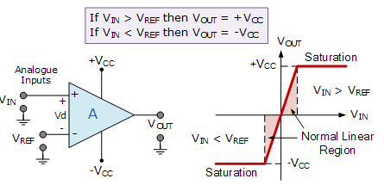
Comparators
Introduction
V_{IN} is less than the DC voltage level at V_{REF}, ( V_{IN} < V_{REF} ). As the non-inverting (positive) input of the comparator is less than the inverting (negative) input, the output will be LOW and at the negative supply voltage, -Vcc resulting in a negative saturation of the output.
If we now increase the input voltage, V_{IN} so that its value is greater than the reference voltage V_{REF} on the inverting input, the output voltage rapidly switches HIGH towards the positive supply voltage, +Vcc resulting in a positive saturation of the output.

Slide 3
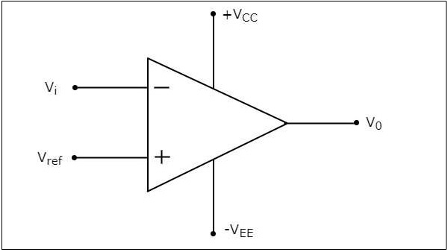
Comparators
Inverting Comparator
An inverting comparator is an op-amp based comparator for which a reference voltage is applied to its non-inverting terminal and the input voltage is applied to its inverting terminal.
The operation of an inverting comparator is very simple. It produces one of the two values, +V_{sat} and −V_{sat} at the output based on the values of its input voltage V_{i} and the reference voltage V_{ref}.

Slide 4
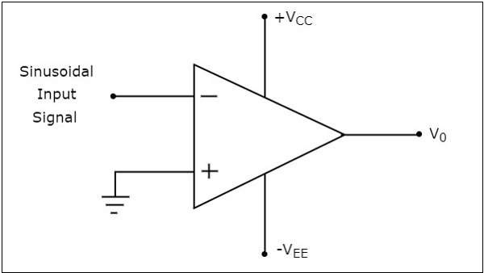
Comparators
Inverting Comparator
The operation of an inverting comparator is very simple. It produces one of the two values, +V_{sat} and −V_{sat} at the output based on the values of its input voltage V_{i} and the reference voltage V_{ref}.
The output value of an inverting comparator will be −V_{sat}, for which the input V_{i} voltage is greater than the reference voltage V_{ref}.
The output value of an inverting comparator will be +V_{sat}, for which the input V_{i} is less than the reference voltage V_{ref}.

Slide 5
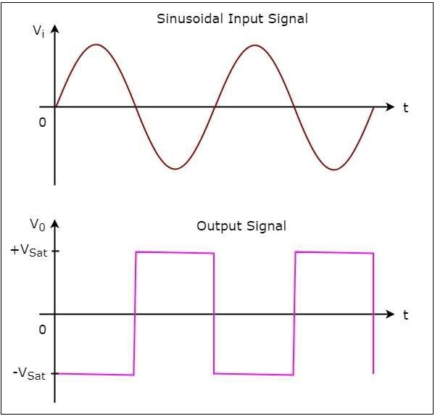
Comparators
Inverting Comparator
The operation of the inverting comparator is;
During the positive half cycle of the sinusoidal input signal, the voltage present at the inverting terminal of op-amp is greater than zero volts. Hence, the output value of the inverting comparator will be equal to −V_{sat} during positive half cycle of the sinusoidal input signal.
Similarly, during the negative half cycle of the sinusoidal input signal, the voltage present at the inverting terminal of the op-amp is less than zero volts. Hence, the output value of the inverting comparator will be equal to +V_{sat} during negative half cycle of the sinusoidal input signal.
The output transitions either from −V_{sat} to +V_{sat} or from +V_{sat} to −V_{sat}.
Output changes its value when the input is crossing zero volts.
Hence, the above circuit is also called as inverting zero crossing detector.

Slide 6
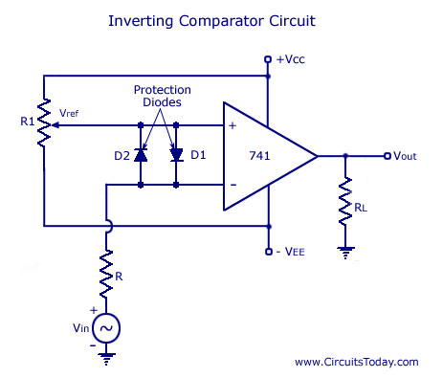
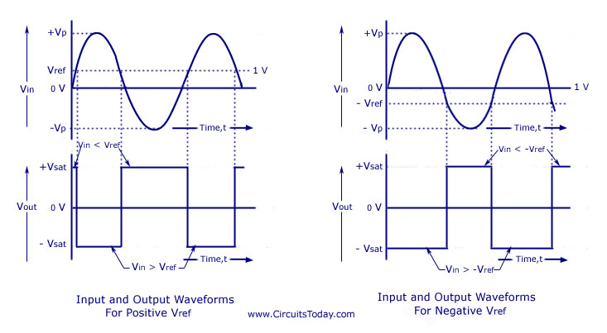
Comparators
Inverting Comparator

Slide 7
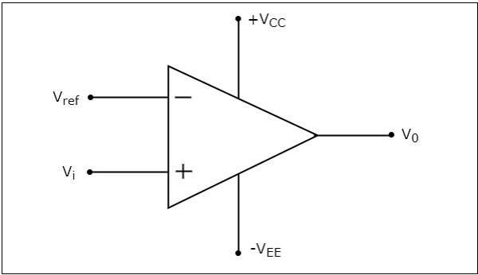
Comparators
Non-Inverting Comparator
A non-inverting comparator is an op-amp based comparator for which a reference voltage is applied to its inverting terminal and the input voltage is applied to its non-inverting terminal.
This op-amp based comparator is called as non-inverting comparator because the input voltage, which has to be compared is applied to the non-inverting terminal of the op-amp.

Slide 8
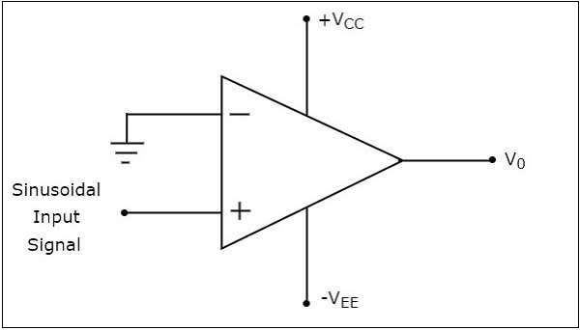
Comparators
Non-Inverting Comparator - operation
It produces one of the two values, +V_{sat} and −V_{sat} at the output based on the values of input voltage Vt and the reference voltage +V_{ref}.
.
The output value of a non-inverting comparator will be +V_{sat} , for which the input voltage Vi is greater than the reference voltage +V_{ref}.
The output value of a non-inverting comparator will bee −V_{sat}, for which the input voltage Vi is less than the reference voltage +V_{ref}.

Slide 9
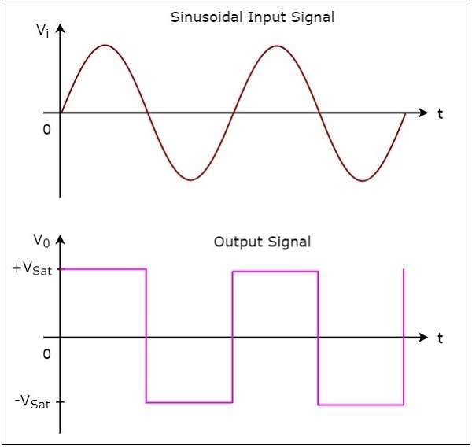
Comparators
Non-Inverting Comparator - operation
During the positive half cycle of the sinusoidal input signal, the voltage present at the non-inverting terminal of op-amp is greater than zero volts. Hence, the output value of a non-inverting comparator will be equal to +V_{sat} during the positive half cycle of the sinusoidal input signal.
Similarly, during the negative half cycle of the sinusoidal input signal, the voltage present at the non-inverting terminal of op-amp is less than zero volts. Hence, the output value of non-inverting comparator will be equal to −V_{sat} during the negative half cycle of the sinusoidal input signal.
The output transitions either from +Vsat to −V_{sat} or from −V_{sat} to +V_{sat}
The output changes its value when the input is crossing zero volts.
Hence, the above circuit is also called as non-inverting zero crossing detector.

Slide 10
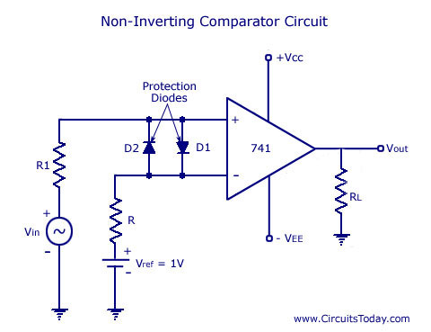
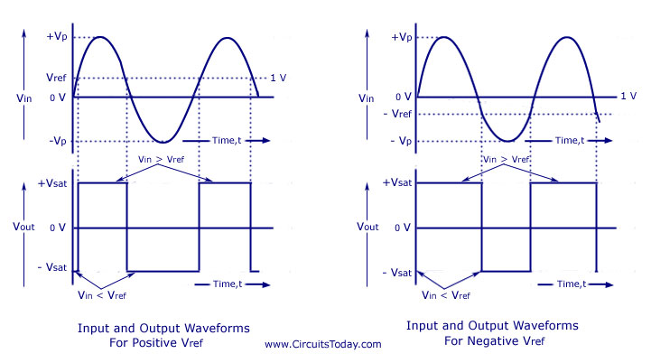
Comparators
Non-Inverting Comparator - operation

Slide 11
Comparators
Comparator - Applications
Zero crossing detector
Window Detector
Time Marker generator
Phase meter
Schmitt trigger

Slide 12
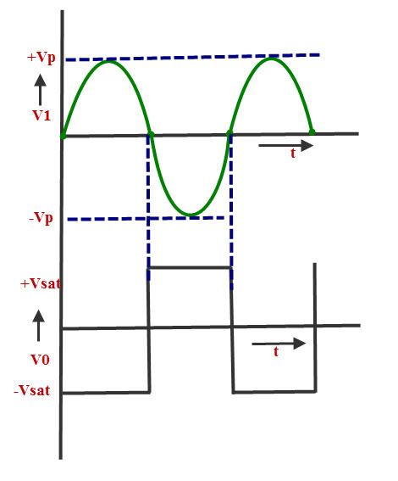
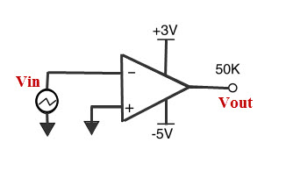
Comparators
Comparator – Zero crossing detector

Slide 13
Comparators
Comparator – Window Detector
A Window Comparator is basically the inverting and the non-inverting comparators above combined into a single comparator stage.
The window comparator detects input voltage levels that are within a specific band or window of voltages.
Using our idea above of a voltage divider network, if we now use three equal value resistors so that R₁ = R₂ = R₃ = R.
So as the resistive values are all equal, the voltage drops across each resistor will also be equal at one-third the supply voltage, 1/3Vcc.
So for ease in this simple window comparator example, we can set the upper reference voltage to 2/3Vcc and the lower reference voltage to 1/3Vcc.

Slide 14
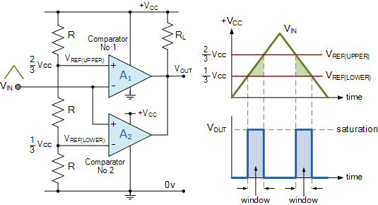
Comparators
Comparator – Window Detector

Slide 15
Comparators
Comparator – Window Detector
The inital switching condition of the circuit is the open-collector output of op-amp A₁ “OFF” with the open-collector output of op-amp A₂, “ON” (sinking current) so V_{OUT} is equal to 0V.
When V_{IN} is below the lower voltage level, V_{REF(LOWER)} which equates to 1/3Vcc, V_{OUT} will be LOW. When V_{IN} exceeds this 1/3Vcc lower voltage level, the first op-amp comparator detects this and switches its open-collector output HIGH. This means that both op-amps have their outputs HIGH at the same time. No current flows through the pull-up resistor R_{L} so V_{OUT} is equal to Vcc.
As V_{IN} continues to increase it passes the upper voltage level, V_{REF(UPPER)} at 2/3Vcc. At this point the second op-amp comparator detects this and switches its output LOW and V_{OUT} becomes equal to 0V.
Then the difference between V_{REF(UPPER)} and V_{REF(LOWER)} (which is 2/3Vccc – 1/3Vcc in this example) creates the switching window for the positive going signal.
Lets now assume that V_{IN} is at its maximum value and equal to Vcc. As V_{IN} decreases it passes the upper voltage level V_{REF(UPPER)} of the second op-amp comparator which switches the output HIGH. As V_{IN} continues to decrease it passes the lower voltage level, V_{REF(LOWER)} of the first op-amp comparator once again switching the output LOW.
Then the difference between V_{REF(UPPER)} and V_{REF(LOWER)} creates the window for the negative going signal. So we can see that as V_{IN} passes above or passes below the upper and lower reference levels set by the two op-amp comparators, the output signal V_{OUT} will be HIGH or LOW.

Slide 16
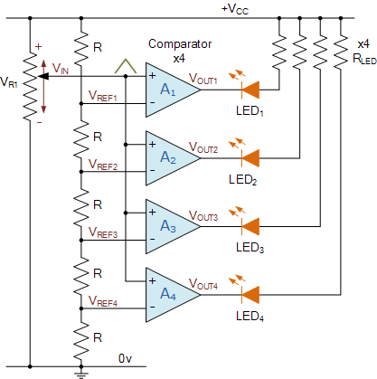
Comparators
Comparator – Window Detector
Comparator Voltage Level Detector

Slide 17
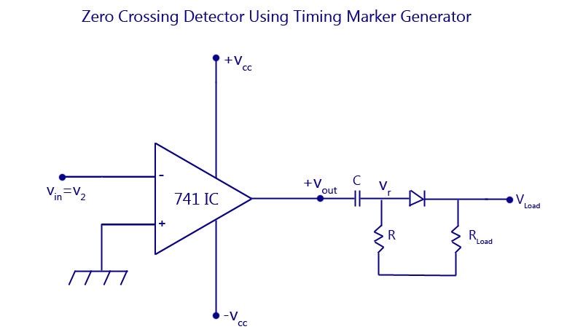
Comparators
Comparator – Time Marker Generator

Slide 18
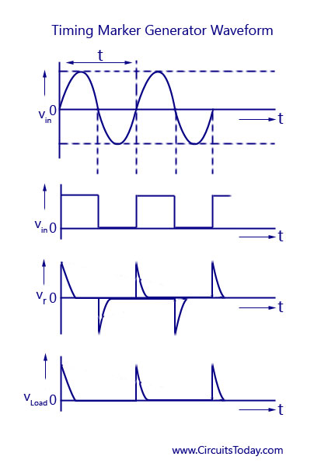
Comparators
Comparator – Time Marker Generator

Slide 19
Comparators
Comparator – Phase meter / Phase Detector
A zero-crossing detector can be used for the measurement of phase angle between two voltages.
The working will be the same as explained in the Time Marker circuit.
A train of pulses in the positive and negative cycles are obtained and the time interval between the pulse of sine wave voltage and that of second sine wave voltage is measured.
This interval of time is proportional to the phase difference between the two input sine wave voltages. The range of use of phasemeter for measurement is 0° to 360°.

Slide 20
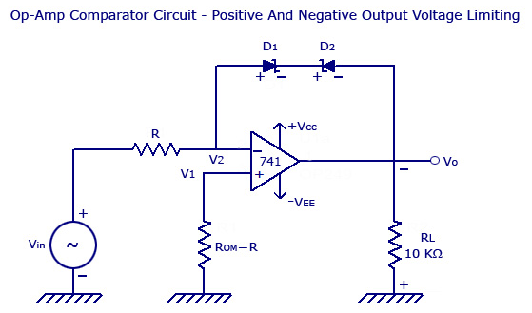
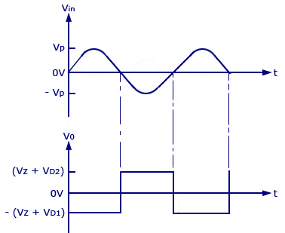
Comparators
Comparator – Voltage Limiter Circuit Using Op-amp

Slide 21
Comparators
Comparator – Voltage Limiter Circuit Using Op-amp
At this condition, V₀ = V_{Z} + V_{D1}
V_{Z} – Zener Voltage
V_{D1} – Voltage drop across D1 = 0.7V
If Vo increases from 0 to negative voltage, Vo increases positively until diode D2 is forward biased and D1 goes into avalanche condition.
A t this condition, V₀ = V_{Z} + V_{D2}
V_{Z} – Zener Voltage
V_{D1} – Voltage drop across D₂ = 0.7V
Thus the limit of output voltage swing is between +(V_{Z} + 0.7) and –(V_{Z} + 0.7).
When V_{in} ranges from 0 to positive voltage, D2 is reverse biased and thus V0 = -V_{sat}.
When V_{in} ranges from 0 to negative voltage, D2 is forward biased and D1 goes into avalanche condition.
Thus V0 = V_{Z} + V_{D2}.

Slide 22
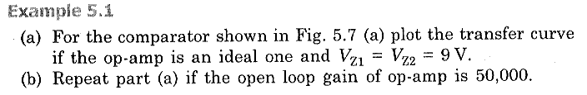
Comparators
Comparator – Voltage Limiter Circuit Using Op-amp

Slide 23
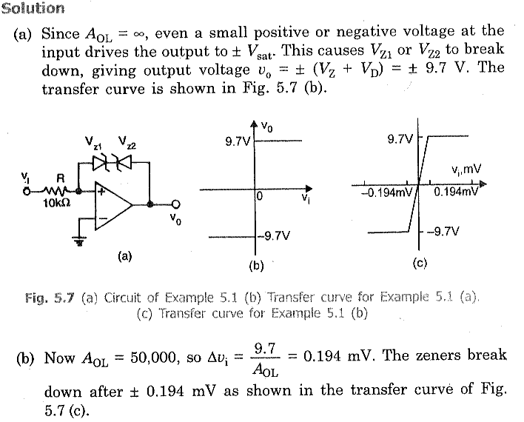
Comparators
Comparator – Voltage Limiter Circuit Using Op-amp

Slide 24
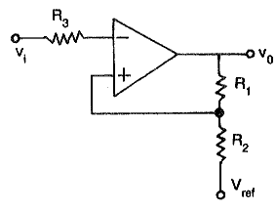
SCHMITT Trigger
Circuit Diagram
Node ‘A’
A Schmitt trigger circuit is also called a regenerative comparator circuit.
It is basically an inverting comparator circuit with a positive feedback.

Slide 25
SCHMITT Trigger
Operation
In an Inverting Schmitt Trigger, the input is applied to the inverting terminal of the Op-Amp.
In this mode, the output produced is of opposite polarity.
This output is applied to non-inverting terminal to ensure positive feedback V_{ref}= (βA_{OL}). A_{OL} is the Open Loop Gain of Op-Amp.
When V_{IN} is slightly greater than V_{A}, the output becomes -V_{SAT} and if V_{IN} is slightly less that -V_{A} (more negative than -V_{REF}), then output becomes V_{SAT}.
Hence, the output voltage V_{O} is either at V_{SAT} or -V_{SAT} and the input voltage at which these state changes occur can be controlled using R₁ and R₂.
The reference voltage V_{REF} and -V_{REF} are called Upper Threshold Voltage V_{UT} and Lower Threshold Voltage V_{LT}.

Slide 26
SCHMITT Trigger
Analysis
Assume initially, the output V₀= +V_{SAT,} then apply nodal analysis at V_{A},
(V_{A}-V_{REF})/R₂ + (V_{A}-V_{SAT})/R₁ = 0 ----(1)
V_{A} = (R₁R₂/R₁+R₂) [V_{REF}/R₂+V_{SAT}/R₁]
Thus, V_{UT} = (1/R₁+R₂)[R₁V_{REF}+R₂V_{SAT}] ----(2)
Similarly, if the output V₀= -V_{SAT,} then apply nodal analysis at V_{A},
(V_{A}-V_{REF})/R₂ + (V_{A}+V_{SAT})/R₁ = 0 ----(3)
V_{A} = (R₁R₂/R₁+R₂) [V_{REF}/R₂-V_{SAT}/R₁]
Thus, V_{LT} = (1/R₁+R₂)[R₁V_{REF}-R₂V_{SAT}] ----(4)

Slide 27
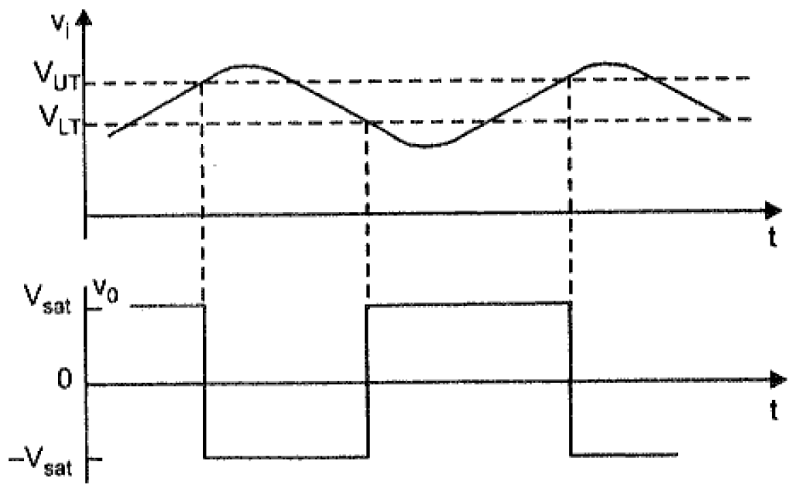
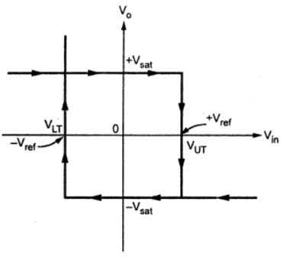
SCHMITT Trigger
Analysis
From eqn. (2) and eqn. (4),
Hysteresis V_{H} = V_{UT} – V_{LT} = (2R₂V_{SAT} /R₁+R₂)
Transfer Characteristic of Schmitt Trigger

Slide 28
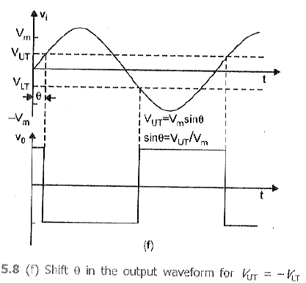
SCHMITT Trigger
Analysis
Consider V_{REF} = 0V then eqn. (2) and eqn. (4) becomes,
V_{UT} = – V_{LT} = (R₂V_{SAT} /R₁+R₂)

Slide 29
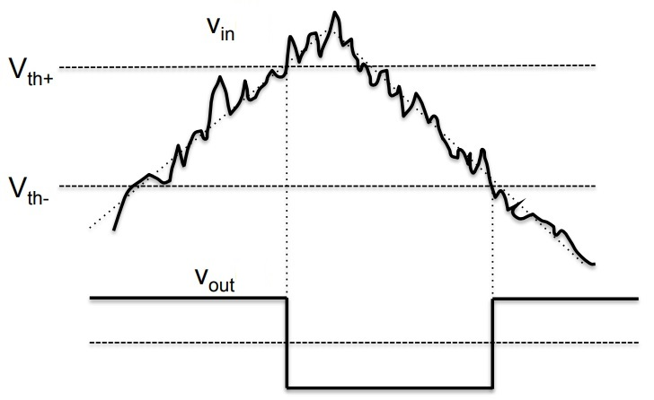
SCHMITT Trigger
Application
One important application of Schmitt Trigger is to convert Sine waves into Square waves.
They can be used to eliminate chatter in Comparators (a phenomenon where multiple output transitions are produced due to swinging of input signal through the threshold region).
They can also act as simple ON / OFF Controllers (for example, temperature based switches).
If we have a noisy input signal as shown figure, the two thresholds of the Schmitt Trigger Circuit will correctly determine the square pulses.
Hence, the basic function of a Schmitt Trigger is to convert noisy square, sine, triangular or any periodic signals into clean square pulses with sharp leading and trailing edges

Slide 30
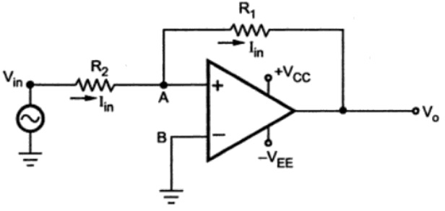
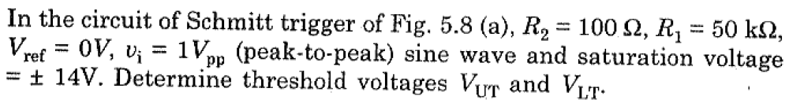
SCHMITT Trigger
Non-Inverting Schmitt Trigger Circuit
Problem

Slide 31
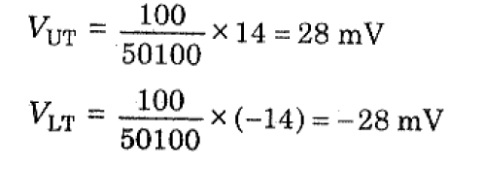
SCHMITT Trigger
Problem

Slide 32
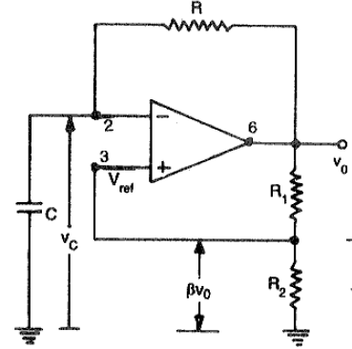
Astable Multivibrator
Circuit Diagram

Slide 33
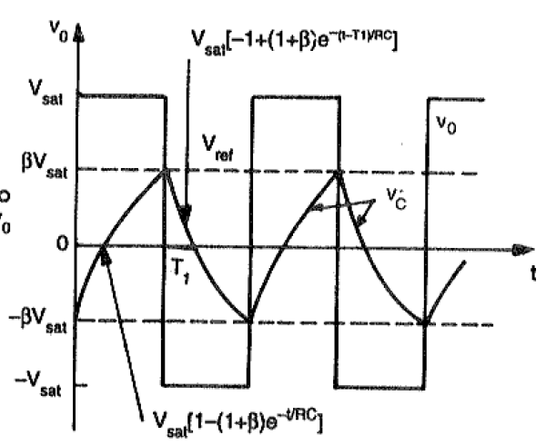
Astable Multivibrator
Output Waveform

Slide 34
Astable Multivibrator
Operation
Firstly lets assume that the capacitor is fully discharged and the output of the op-amp is saturated at the positive supply rail.
The capacitor, C starts to charge up from the output voltage, Vout through resistor, R at a rate determined by their RC time constant.
RC circuits that the capacitor wants to charge up fully to the value of Vout (which is +V(sat)) within five time constants.
However, as soon as the capacitors charging voltage at the op-amps inverting (-) terminal is equal to or greater than the voltage at the non-inverting terminal (the op-amps output voltage fraction divided between resistors R1 and R2), the output will change state and be driven to the opposing negative supply rail.

Slide 35
Astable Multivibrator
Operation
Once the op-amps inverting terminal reaches the new negative reference voltage, -Vref at the non-inverting terminal, the op-amp once again changes state and the output is driven to the opposing supply rail voltage, +V(sat).
The capacitor now see’s a positive voltage across its plates and the charging cycle begins again. Thus, the capacitor is constantly charging and discharging creating an astable op-amp multivibrator output.

Slide 36
Astable Multivibrator
Operation
When power is turned ON, V₀ automatically swings either +V_{sat} or to –V_{sat} since these are the only stable states allowed by Schmitt trigger. Assume it swings to +V_{sat}.
Now capacitor starts charging towards +V_{sat} through the feedback path provided by the resistor R to the inverting input. As long as the capacitor voltage V_{c} is less than +βV_{sat}, the output voltage remains at +V_{sat}
As soon as V_{c} charges to a value slightly greater than +βV_{sat}, the input goes positive with respect to the input. This switches the output voltage from +V_{sat} to -V_{sat}
As V₀ switches to -V_{sat}, capacitor starts discharging via . The current I discharges capacitor to 0 V and recharges capacitor to –βV_{sat.} When V_{c} becomes slightly more negative than the feedback voltage –βV_{sat,} output voltage switches back to +V_{sat}

Slide 37
Astable Multivibrator
Analysis
Voltage across Capacitor at time t is given by the eqn. as
V_{c}(t) = V_{f} + (V_{i} - V_{f}) e^{(-t/RC)} ----(1)
Where V_{f} is Final Value = +V_{sat}
V_{i} is Initial Value = -βV_{sat}
V_{c}(t) = +V_{sat} + (-βV_{sat} - V_{sat}) e^{(-t/RC)} ----(2)
V_{c}(t) = +V_{sat} - V_{sat}(1+β) e^{(-t/RC)} ----(3)
At t= T₁, then V_{c} = +βV_{sat} and Switching Takes place, therefore,
V_{c}(T₁) = βV_{sat} = +V_{sat} - V_{sat}(1+β) e^{(-T}₁^{/RC)} ----(4)

Slide 38
Astable Multivibrator
Analysis
Solving eqn. (4) gives,
T₁ = RC ln ((1+β)/(1-β)) ----(5)
eqn. (5) for half a cycle, for full cycle,
T = 2T₁ = 2RC ln ((1+β)/(1-β)) ----(6)
If R₁=R₂ then, β = 0.5,
T = 2RC ln 3 ----(7)
If R₁=1.16R₂ then,
T = 2RC ----(8)
f = 1/2RC ----(9)
V_{pp} = 2V_{sat} ----(10)

Slide 39
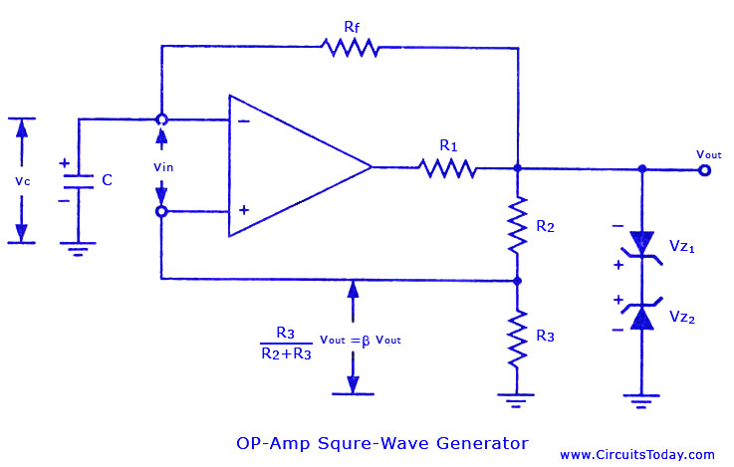
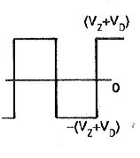

Astable Multivibrator
Analysis

Slide 40
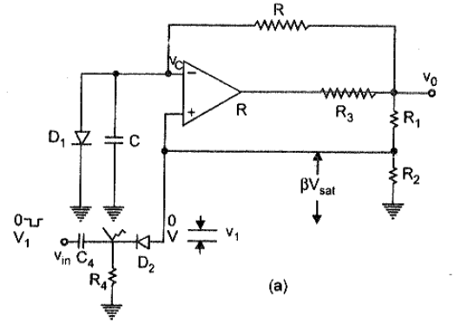
Monostable Multivibrator
Circuit Diagram

Slide 41
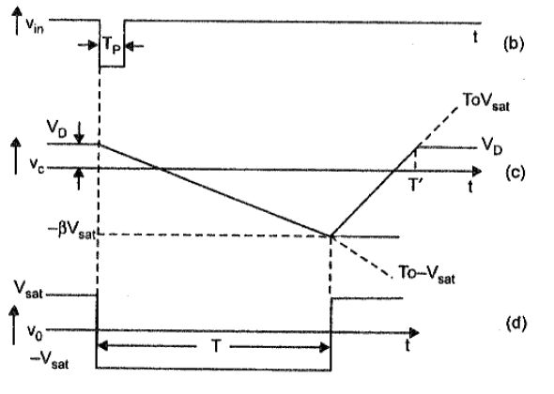
Monostable Multivibrator
Output Waveforms

Slide 42
Monostable Multivibrator
Operation
The monostable multivibrator is also called as
One-shot multivibrator
Time delay circuit
Gating Circuit
The circuit produces a single pulse of specified duration in response to each external trigger signal. For such a circuit, only one stable state exists.
When an external trigger is applied, the output changes its state. The new state is called as a quasi-stable state. The circuit remains in this state for a fixed interval of time. After some time it returns back to its original stable state.
In fact, an internal trigger signal is generated which drives the circuit back to its original stable state. Usually, the charging and discharging of a capacitor provide this internal trigger signal.

Slide 43
Monostable Multivibrator
Operation
The diode D₁ connected across the capacitor is called clamping diode. It clamps the capacitor voltage to 0.7V when the output is at +V_{sat}.
A negative triggering pulse is applied to the Non-inverting terminal of Op-amp through RC differentiator circuit and diode D₂.
To understand the operation of the circuit, let us assume that the output V₀ is at +V_{sat} i.e. in its stable state.
The diode D₁ (Connected across Capacitor) conducts and the voltage across the capacitor C => V_{C} gets clamped to 0.7V Volts.
The voltage at the non-inverting terminal is controlled by voltage divider circuit of R₁ and R_{2.}
Voltage at non-inverting terminal (V₂) = βV₀ {where, β= (R₂/(R₁+R₂))}

Slide 44
Monostable Multivibrator
Operation
If V₁, a negative trigger of amplitude V₁ is applied to the non-inverting terminal, so that the effective voltage at this terminal is less than 0.7V. Then the output of the Op-amp changes its state from +V_{sat} to -V_{sat.}
The diode is now reverse biased and the capacitor starts charging exponentially to -V_{sat} through resistance R.
The voltage at the non-inverting terminal is now -βV₀.When the capacitor voltage becomes just slightly more negative than -βV_{0,} the output of the Op-amp changes its state back to +V_{0.}
The capacitor now starts charging towards +V₀ through R until V_{C} reaches 0.7V as capacitor gets clamped to the voltage.

Slide 45
Monostable Multivibrator
Analysis
Voltage across Capacitor at time t is given by the eqn. as
V_{c}(t) = V_{f} + (V_{i} - V_{f}) e^{(-t/RC)} ----(1)
Where V_{f} is Final Value = -V_{sat}
V_{i} is Initial Value = V_{D1}
V_{c}(t) = -V_{sat} + (V_{D1} + V_{sat}) e^{(-t/RC)} ----(2)
At t= T, then V_{c} = -βV_{sat} and Switching Takes place, therefore,
V_{c}(T) = --βV_{sat} = -V_{sat} (V_{D1} + V_{sat}) e^{(-T/RC)} ----(3)

Slide 46
Monostable Multivibrator
Analysis
Solving eqn. (3) gives,
T₁ = RC ln ((1+V_{D1}/V_{sat})/(1-β)) ----(4)
where, β= (R₂/(R₁+R₂))
If V_{sat} >> V_{D1} and R₁=R₂ then, β = 0.5,
T = 0.69 RC ----(5)

Slide 47
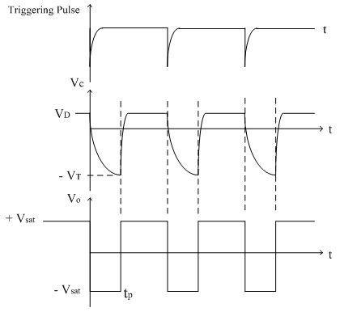
Monostable Multivibrator
NOTE:
For Monostable operation, the trigger pulse width T_{p} should be much less than T.
The diode D₂ is not essential but it is used to avoid malfunctioning if any positive noise spikes are present in triggering line.
It can be seen from the waveform that the voltage V_{C} does not reach its quiescent value V_{D1} until time T’>T. Hence it is necessary that a recovery time (T’>T) be allowed to elapse before the next triggering signal is applied.

Slide 48
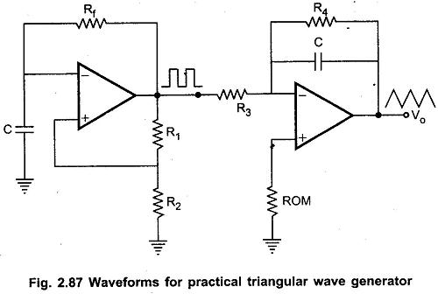
Triangular wave Generator
Method:1
Circuit Diagram

Slide 49
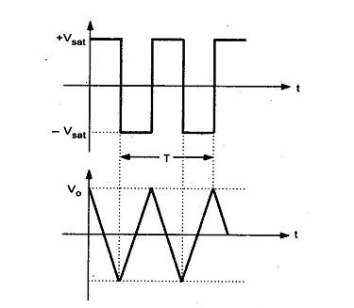
Triangular wave Generator
Method:1
Circuit Diagram

Slide 50
Triangular wave Generator
Method:1
Operation
Basically, triangular wave is generated by alternatively charging and discharging a capacitor with a constant current.
This is achieved by connecting integrator circuit at the output of square wave generator. Assume that V’ is high at +V_{sat}.
This forces a constant current (+V_{sat} / R₃) through C (left to right) to drive V_{o} negative linearly.
When V’ is low at -V_{sat}, it forces a constant current (-V_{sat} / R₃) through C (right to left) to drive V_{o} positive, linearly.
The frequency of the triangular wave is same as that of square wave.
Although the amplitude of the square wave is constant (±V_{sat}), the amplitude of the triangular wave decreases with an increase in its frequency, and vice versa.
This is because the reactance of capacitor decreases at high frequencies and increases at low frequencies.
In practical circuits, resistance R₄ is connected across C to avoid the saturation problem at low frequencies as in the case of practical integrator

Slide 51
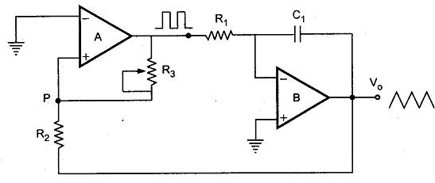
Triangular wave Generator
Method:2
Circuit Diagram
Another triangular wave generator, which requires fewer components

Slide 52
Triangular wave Generator
Method:2
Operation
It consists of a comparator (A) and an integrator (B).
The output of comparator A is a square wave of amplitude ± V_{sat} and is applied to the inverting (-) input terminal of the integrator B.
The output of integrator is a triangular wave and it is feedback as input to the comparator A through a voltage divider R₂ R₃.
To understand circuit operation, assume that the output of comparator A is at + V_{sat} .
This forces a constant current (+ V_{sat} / R₁) through C to give a negative going ramp at the output of the integrator, as shown in the Fig..
Therefore, one end of voltage divider is at a voltage +V_{sat} and the other at the negative going ramp.
When the negative going ramp reaches a certain value -V_{ramp}, the effective voltage at point P becomes slightly below 0V.

Slide 53
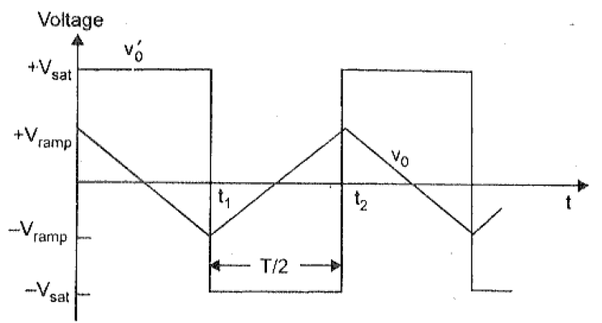
Triangular wave Generator
Method:2
Output waveform

Slide 54
Triangular wave Generator
Method:2
Operation
As a result, the output of comparator A switches from positive saturation to negative saturation (-V_{sat}).
This forces a reverse constant current (right to left) through C to give a positive going ramp at the output of the integrator, as shown in the Fig.
When positive going ramp reaches + V_{ramp}, the effective voltage at point P becomes slightly above 0V.
As a result, the output of comparator A switches from negative saturation to positive saturation (+V_{sat}).
The sequence then repeats to give triangular wave at the output of integrator B.

Slide 55

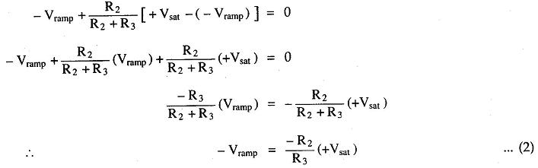
Triangular wave Generator
Method:2
Amplitude and Frequency Calculation
When comparator output is at +V_{sat}, the effective voltage at point P is given by
When effective voltage at P becomes equal to zero, we can write above equation

Slide 56

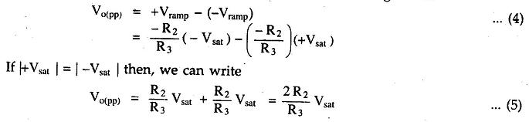
Triangular wave Generator
Method:2
Amplitude and Frequency Calculation
Similarly, when comparator output is at -V_{sat ,}we can write,
The peak to peak amplitude of the triangular wave can be given as

Slide 57
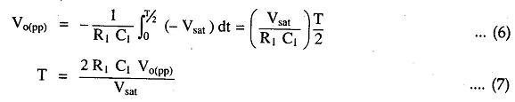


Triangular wave Generator
Method:2
Amplitude and Frequency Calculation
The time taken by the output to swing from – V_{ramp} to + V_{ramp} (or from + V_{ramp} to – V_{ramp}) is equal to half the time period T/2
Substituting value of V_{o(pp)} we get,
Therefore, the frequency of oscillation can be given as,

Slide 58
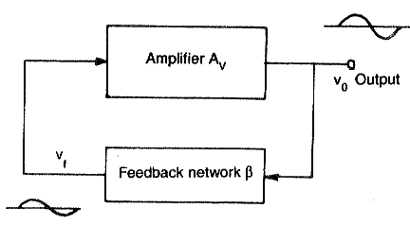

Sine wave Generator
Barkhausen criteria
Electronic oscillators are divided into:
Sinusoidal (or harmonic) oscillators-which produce an output having sine waveform
Non-sinusoidal (or relaxation) oscillator-the output is square, rectangular or saw-tooth or pulse shape.
A(jω)β(jω) = 1(0°)
The total phase shift of the loop gain should be Zero ro multiple of 2Π.
The magnitude of the loop gain Aβ is equal to unity |Aβ| = 1.

Slide 59
Sine wave Generator
Types of Oscillators
There are two types,
RC Phase Shift Oscillators - Audio Frequencies (Hz to kHz)
LC Oscillators – High Frequencies (in MHz)

Slide 60
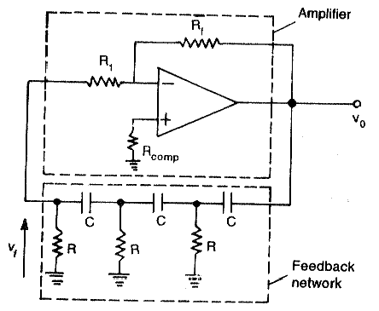
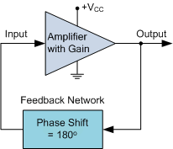
RC Phase Shift Oscillators
Circuit Diagram

Slide 61
RC Phase Shift Oscillators
Description
R-C phase shift oscillator using op-amp uses an op-amp in inverting amplifier mode. Thus it introduces the phase shift of 180° between input and output. The feedback network consists of 3 RC sections each producing 60° phase shift.
The output of the amplifier is given to the feedback network. The output of the feedback network drives the amplifier. The total phase shift around a loop is 180° of the amplifier and 180° due to 3 RC section, thus 360°. This satisfies the required condition for positive feedback and circuit works as an oscillator.
The gain of the amplifier or op-amp is adjusted with help of R_{f} and R₁ resistances. To get the required oscillations, the gain is adjusted in such a way that the product of op-amp gain and gain of feedback network is slightly greater than 1.

Slide 62
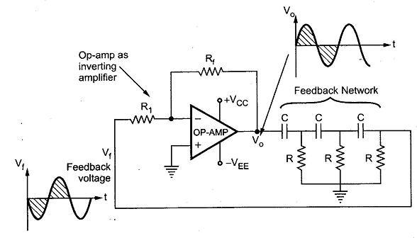
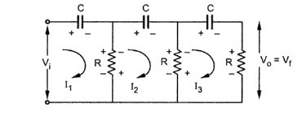
RC Phase Shift Oscillators
Analysis
Let us find the transfer function of the RC feedback network :

Slide 63
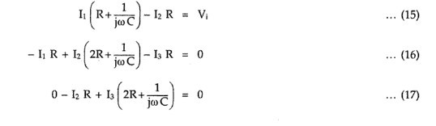
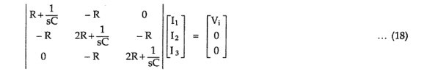
RC Phase Shift Oscillators
Analysis
Applying KVL to various loops we get,
Replacing jω by s and writing the equations in the matrix form,

Slide 64

RC Phase Shift Oscillators
Analysis
Using the Crammer’s rule to obtain I₃

Slide 65

RC Phase Shift Oscillators
Analysis

Slide 66


RC Phase Shift Oscillators
Analysis

Slide 67


RC Phase Shift Oscillators
Analysis
This is the frequency with which circuit oscillates,
At this frequency, (sub. Α value in β (eqn. 23))
The negative sign indicates a phase shift of 180°

Slide 68
RC Phase Shift Oscillators
Analysis
Thus circuit will work as an oscillator which will produce a sinusoidal waveform if the gain (A) is 29 and total phase shift around a loop is 360°.
This satisfies the Barkhausen criterion for the oscillator.
These oscillators are used over the audio frequency range i.e. about 20 Hz up to 100 kHz.

Slide 69
RC Phase Shift Oscillators
Advantages
The circuit is simple to design.
Can produce output over the audio frequency range.
Produces sinusoidal output waveform.
It is a fixed-frequency oscillator.
Disadvantages
By changing the values of R and C, the frequency of the oscillator can be changed. But this is practically impossible. Hence the phase shift oscillator is considered as a fixed frequency oscillator, for all practical purposes.
And the frequency stability is poor due to the changes in the values of various components, due to the effect of temperature, ageing etc.

Slide 70


RC Phase Shift Oscillators
Problems

Slide 71

Wien Bridge Oscillators
Circuit Diagram

Slide 72
Wien Bridge Oscillators
Description
Generally in an oscillator, amplifier stage introduces 180° phase shift and feedback network introduces additional 180° phase shift, to obtain a phase shift of 360° around a loop. This is required condition for any oscillator.
But wiens bridge oscillator uses a non inverting amplifier and hence does not provide any phase shift during amplifier stage. As total phase shift required is 0°, in wiens bridge type no phase shift is necessary through feedback. Thus the total phase shift around a loop is 0°.
The two arms of the bride, namely R₁ and C₁ in series and R₂ and C₂ in parallel are called frequency sensitive arms. This is because the components of these two arms decide the frequency of the oscillator.

Slide 73


Wien Bridge Oscillators
Analysis

Slide 74






Wien Bridge Oscillators
Analysis
Now replacing

Slide 75



Wien Bridge Oscillators
Analysis
Substituting the values of and

Slide 76




Wien Bridge Oscillators
Analysis
Replacing s by jω

Slide 77



Wien Bridge Oscillators
Analysis
Rationalising the expression
To have zero phase shift of the feedback network, its imaginary part must be zero
This is the frequency of the oscillator and it shows that the components of the frequency sensitive arms are the deciding factors, for the frequency.

Slide 78


Wien Bridge Oscillators
Analysis
In practice, R₁ = R₂ = Rand C₁ = C₂ = C are selected.
Magnitude of the feedback factor at the resonating frequency is ,
β = 1/3
The positive sign of β indicates that the phase shift by the feedback network is 0°. Now to satisfy the barkhausen criterion for the sustained oscillations, we can write,
A = (1+(R_{f}/R₃))
A>3; hence,
(R_{f}/R₃) >2

Slide 79
Wien Bridge Oscillators
Advantages
By varying the two capacitor values simultaneously, by mounting them on the common shaft, different frequency ranges can be obtained.
The perfect sine wave output is possible.
It is useful audio frequency range i.e. 20 Hz to 100 kHz.
Disadvantages
The frequency stability is poor.

Slide 80
https://eeebooks4u.wordpress.com/2017/04/02/rc-phase-shift-oscillator/
http://avitec13.weebly.com/linear-integrated-circuits-lic1.html
https://www.eeeguide.com/triangular-wave-generator-using-op-amp/

Slide 81

Wein Bridge Derivation

